Slide 1
Simple Classification Creator
Prototype

Slide 2
What are we trying to do?
An automated way to create one or more classifications in bulk, including rules.
Allows for Basic or Advanced Rules (or no rules)
Allows for Element or Entity Classifications
Uses Templates to allow for versatility
Logic added for dealing with nested lists

Slide 3
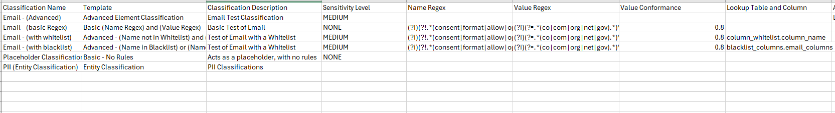
Configure with csv file
Provide the Classification Name
Provide the Template to use
All other fields are completely dependent on which Template you use. For example:
The Basic Regex template takes Name Regex and Value Regex
The No Rules template just needs a Name, Description, and Sensitivity Level
The Entity Classification template needs a Name, Description, comma separated list of classifications, and Inclusion Scope

Slide 4
Included Templates: Basic (Name Regex) and (Value Regex)
{
"basicExpressionElements":[
{
"type":"SIMPLE_PREDICATE",
"predicateValue":{
"attribute":"NAME",
"operator":"RLIKE",
"valueType":"JAVA_REGEX",
"values":[
"{Name Regex}"
],
"conformance":null
}
},
{
"type":"AND"
},
{
"type":"SIMPLE_PREDICATE",
"predicateValue":{
"attribute":"FREQUENT_VALUES",
"operator":"RLIKE",
"valueType":"JAVA_REGEX",
"values":[
"{Value Regex}"
],
"conformance":"{Value Conformance}",
"weightedConformance":true
}
}
],
"name":"{Classification Name}",
"description":"{Classification Description}",
"classificationType":"DATA_ELEMENT",
"updatedBy":"",
"updatedByName":"",
"updateTime":0,
"expressionContext":{
"constants":[
]
},
"expressionMode":"BASIC",
"sensitivity":"{Sensitivity Level}"
}
Good common one to use with Regexes
Parameters for Template:
}
Classification Name. Name of the classification. Needs to be unique or the script will error and skip.
Classification Description. Description of the Classification
Sensitivity Level. NONE, LOW, MEDIUM, HIGH (or can be customized in MCC)
Name Regex. Regex for matching on the field name
Value Regex. Regex for matching on the frequent values
Value Conformance. Percentage of value matches expressed between 0.1 -1.0

Slide 5
Included Templates: Advanced - (Name not in Whitelist) and (Name Regex) and (Value Regex)
Parameters for Template:
}
Classification Name. Name of the classification. Needs to be unique or the script will error and skip.
Classification Description. Description of the Classification
Sensitivity Level. NONE, LOW, MEDIUM, HIGH (or can be customized in MCC)
Lookup Table and Column. The whitelist lookup table, and column to evaluate against the column name. Column names in this whitelist will not be classified as this classification.
Name Regex. Regex for matching on the field name
Value Regex. Regex for matching on the frequent values
Value Conformance. Percentage of value matches expressed between 0.1 -1.0
{
"inclusionRule": "( NAME NOT IN {Lookup Table and Column} ) AND\r\n( NAME RLIKE '{Name Regex}' \r\n AND (aggregate(filter(VALUE_FREQUENCIES, v -> v.VALUE RLIKE '{Value Regex}'),0D,(acc, v) -> acc + v.FREQUENCY_PERCENTAGE) / aggregate(VALUE_FREQUENCIES, 0D, (acc, v) -> acc + v.FREQUENCY_PERCENTAGE)) >= {Value Conformance}d )",
"name": "{Classification Name}",
"description": "{Classification Description}",
"sensitivity": "{Sensitivity Level}",
"classificationType": "DATA_ELEMENT",
"origin": "USER_DEFINED",
"expressionContext": {
"constants": null,
"lookupTableReferences": null
},
"expressionMode": "ADVANCED"
}

Slide 6
Included Templates: Advanced - (Name in Blacklist) or (Name Regex) and (Value Regex)
Parameters for Template:
}
Classification Name. Name of the classification. Needs to be unique or the script will error and skip.
Classification Description. Description of the Classification
Sensitivity Level. NONE, LOW, MEDIUM, HIGH (or can be customized in MCC)
Lookup Table and Column. The blacklist lookup table, and column to evaluate against the column name. Column names in this blacklist will be classified as this classification.
Name Regex. Regex for matching on the field name
Value Regex. Regex for matching on the frequent values
Value Conformance. Percentage of value matches expressed between 0.1 -1.0
{
"inclusionRule": "( NAME IN {Lookup Table and Column} ) OR\r\n( NAME RLIKE '{Name Regex}' \r\n AND (aggregate(filter(VALUE_FREQUENCIES, v -> v.VALUE RLIKE '{Value Regex}'),0D,(acc, v) -> acc + v.FREQUENCY_PERCENTAGE) / aggregate(VALUE_FREQUENCIES, 0D, (acc, v) -> acc + v.FREQUENCY_PERCENTAGE)) >= {Value Conformance}d )",
"name": "{Classification Name}",
"description": "{Classification Description}",
"sensitivity": "{Sensitivity Level}",
"classificationType": "DATA_ELEMENT",
"origin": "USER_DEFINED",
"expressionContext": {
"constants": null,
"lookupTableReferences": null
},
"expressionMode": "ADVANCED"
}

Slide 7
Included Templates: Advanced Element Classification
Parameters for Template:
}
Classification Name. Name of the classification. Needs to be unique or the script will error and skip.
Classification Description. Description of the Classification
Sensitivity Level. NONE, LOW, MEDIUM, HIGH (or can be customized in MCC)
Advanced Rule. Raw Advanced Rule. Use with caution
{
"inclusionRule": "{Advanced Rule}",
"name": "{Classification Name}",
"description": "{Classification Description}",
"sensitivity": "{Sensitivity Level}",
"classificationType": "DATA_ELEMENT",
"origin": "USER_DEFINED",
"expressionContext": {
"constants": null,
"lookupTableReferences": null
},
"expressionMode": "ADVANCED"
}

Slide 8
Included Templates: Basic - No Rules
Great for using with Generated Data Classification
Parameters for Template:
}
Classification Name. Name of the classification. Needs to be unique or the script will error and skip.
Classification Description. Description of the Classification
{
"name":"{Classification Name}",
"description":"{Classification Description}",
"sensitivity":"NONE",
"classificationType":"DATA_ELEMENT",
"origin":"USER_DEFINED",
"expressionContext":{
"constants":null,
"lookupTableReferences":null
},
"expressionMode":"NONE",
"inclusionRule":null,
"basicExpressionElements":null
}

Slide 9
Included Templates: Entity Classification
Parameters for Template:
{
"name":"{Classification Name}",
"description":"{Classification Description}",
"sensitivity":null,
"classificationType":"DATA_ENTITY",
"origin":"USER_DEFINED",
"inclusionRule":{
"function":"N_OF",
"nValue":{Inclusion Scope},
"classifications": {Entity Classification Array:Classification Members}
}
}
}
Classification Name. Name of the classification. Needs to be unique or the script will error and skip.
Classification Description. Description of the Classification
Inclusion Scope. Number of entities required to include dataset in classification
Entity Classification Array:Classification Members. Loops through the value and for each, uses additional template “Entity Classification Array”, and replaces attribute “Classification Members”
{
"id":"{Classification Members}",
"classificationType":"DATA_ELEMENT"
}
* Note that “Classification Members” is a special token. When the script finds this, it will trigger the extraction, and then use the extraction files to replace the Classification Names with the ids, making it convenient for Entity Classifications

Slide 10

Configure Lookup Tables with csv file
Create a csv file that contains your lookup table
Then use the configuration to create or update lookup tables
When lookup tables are created / updated, a job will start, and the script will monitor and wait for that job to complete (as jobs can only run one at a time)
Optionally, you can add the Action of “DELETE” to remove the lookup table
Provide the Lookup Table Name
Provide the name of the csv file that contains the lookup table data (in the same location as the script
Provide the Lookup Table Description

Slide 11
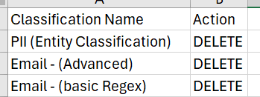
Other Options
Script can also be made to extract existing Classifications. By default, it’ll only do this when it’s needed (setting up Entity Classifications, for example). You can force the extract with a command line parameter
Deleting Classifications are done by executing a job. You can execute them in bulk by formatting a simple csv file with the Classification Name and/or Lookup Table Name, and Action (set to DELETE). You can run the script with the delete command line parameter, and optionally the csv file that contain the classifications to be deleted.
python simple_classification_creator.py extract
python simple_classification_creator.py delete python simple_classification_creator.py delete my_delete_file.csv simple_classification_creator.exe delete

Slide 12
Additional Information
You will be prompted to choose a csv file to use for configuration
Template files are stored in the “./templates” folder
json files of what will be loaded will be stored in ./payloads/payload_<timestamp> folder
extracts are stored in the “./extracts” folder
Additional flags can be set on the script (or via command line using --<parameter>=<value> run with --help for all parameters):
default_pod. Set this to the default Informatica POD to use. Example: dm-us
default_user. Set this to the default user to use. Example: shayes_compass
default_pwd. Set this to the default password to use. Example: 1234
prompt_for_login_info. True/False. Whether or not to prompt. If False, will not prompt, unless default is not set
pause_before_loading. True/False. Whether or not to pause after payload files are created, before loading the classifications.
create_payloads_only. True/False. If set to True, will only create the payload files, without loading anything. Good for testing
when_extracting_fetch_details. True/False. If set to True, when extracting classifications, it will also fetch the details for any user created classifications
show_raw_errors. True/False. If set to True, it will always show raw errors if they occur. Otherwise, it will attempt to find the message from the error, and display that.
skip_existing_lookup_tables. True/False. If set to True, and a lookup table is defined that already exist, it will skip it.
If desired, you can create a credentials to save your defaults in ~/.informatica_cdgc path (c:\users\<username>\.informatica_cdgc). Example of that file is:
[default1] pod = dmp-us user = shayes_example pwd = xyz [shayes_compass] pod = dmp-us user = shayes_compass pwd = abc [reinvent] pod = dm-us user = reinvent01 pwd = zyx

Slide 13
Command Line Options
Optionally, you can set parameters:
--help
This will display all command line options
--default_user
You can specify the username to use. if you do now specify one, it will look in the
~/.informatica_cdgc/credentials file (as shown below)
Example:
--default_user=shayes_compass
--default_pwd
You can specify the password to use. if you do now specify one, it will look in the
~/.informatica_cdgc/credentials file (as shown below)
Example:
--default_pwd=12345
--default_pod
You can specify the pod to use. if you do now specify one, it will look in the
~/.informatica_cdgc/credentials file (as shown below)
Typically this "pod" can be shown in the url: for example: "dm-us"
Example:
--default_pwd=dm-us
--csv_file
You can specify the config csv file to use directly, by setting it here.
It will default to the directory where the script/exe file resides.
Example:
--csv_file=my_classifications.csv
--csv_file_path
You can specify the config csv file to use directly, by setting it here.
Setting it with this option, will allow you to specify the full path (use linux forward slashes)
Example:
--csv_file_path=c:/junk/my_classifications.csv
--skip_existing_lookup_tables
If a Lookup table is defined, and it already exists, you can specify whether to upddate
the lookup table, or skip it. If set to True, it will skip existing lookup tables.
If set to False (default), it will update the lookup table.
Example:
--skip_existing_lookup_tables=True
Direct Command line options:
delete
Use this command line argument to specify delete classifications action.
extract
Use this command to simply extract user created classifications. Use this to create
additional templates. The "details" that it downloads will provide the correct syntax for
templates.

Slide 14
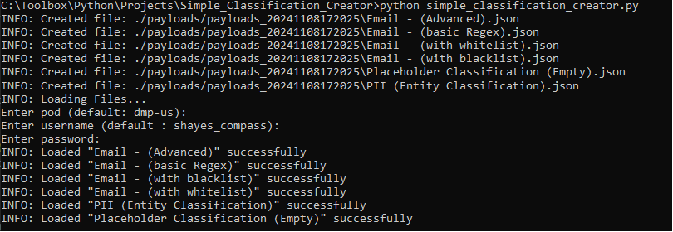
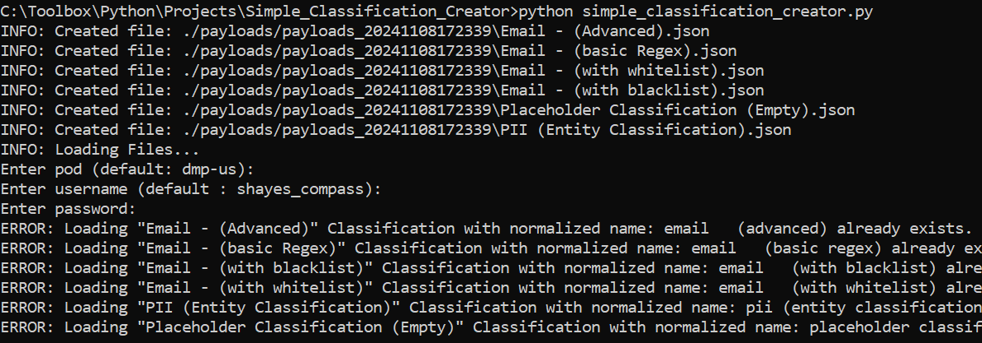
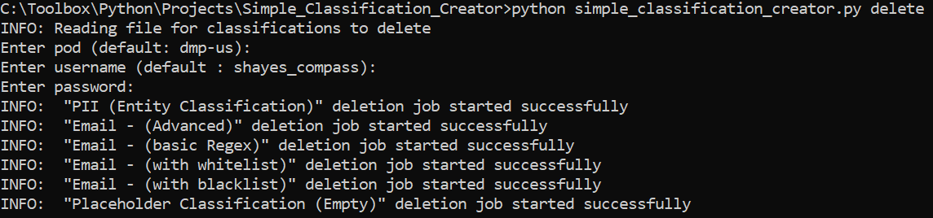
Output
Sample Output:
Note that if an error occurs, it will skip that classification and continue

Slide 15
Thank You
Questions / Issues / Suggestions:
Scott Hayes
shayes@informatica.com

